Slide 1
Data Mining Project
Kreethi mishra
AP19110010424
CSE-C

Slide 2
INTRODUCTION
For this project I attempted to use KMeans Clustering to cluster Universities into two groups, Private and Public.
Note, I actually have the labels for this data set, but I did NOT use them for the KMeans clustering algorithm, since that is an unsupervised learning algorithm.
This project focuses on investigating the application of KDD to explore and discover patterns within the University dataset.
When using the K Means algorithm under normal circumstances, it is because you don't have labels. In this case I used the labels to try to get an idea of how well the algorithm performed, but you won't usually do this for Kmeans.

Slide 3
DATA SET USED(UNIVERSITY DATASET)
The DataSet used for the project:
I used a data frame with 777 observations on the following 18 variables.
Private A factor with levels No and Yes indicating private or public university
Apps Number of applications received
Accept Number of applications accepted
Enroll Number of new students enrolled
Top 10 Perc Pct. new students from top 10% of H.S. class
Top 25 Perc Pct. new students from top 25% of H.S. class
F.Undergrad Number of full time undergraduates
P.Undergrad Number of part time undergraduates
Outstate Out-of-state tuition
Room.Board Room and board costs
Books Estimated book costs
Personal Estimated personal spending
PhD Pct. of faculty with Ph.D.’s
Terminal Pct. of faculty with terminal degree
S.F.Ratio Student/faculty ratio
perc.alumni Pct. alumni who donate
Expend Instructional expenditure per student
Grad.Rate Graduation rate

Slide 4
MECHANISHM USED
K Means Clustering is an unsupervised learning algorithm that tries to cluster data based on their similarity. Unsupervised learning means that there is no outcome to be predicted, and the algorithm just tries to find patterns in the data. In k means clustering, we have to specify the number of clusters we want the data to be grouped into. The algorithm randomly assigns each observation to a cluster, and finds the centroid of each cluster. Then, the algorithm iterates through two steps: Reassign data points to the cluster whose centroid is closest. Calculate new centroid of each cluster. These two steps are repeated till the within cluster variation cannot be reduced any further. The within cluster variation is calculated as the sum of the euclidean distance between the data points and their respective cluster centroids.

Slide 5
EXPLANATION OF THE MECHANISM USED
K-Means Clustering is an Unsupervised Learning algorithm, which groups the unlabeled dataset into different clusters. Here K defines the number of predefined clusters that need to be created in the process, as if K=2, there will be two clusters, and for K=3, there will be three clusters, and so on.It allows us to cluster the data into different groups and a convenient way to discover the categories of groups in the unlabeled dataset on its own without the need for any training.It is a centroid-based algorithm, where each cluster is associated with a centroid. The main aim of this algorithm is to minimize the sum of distances between the data point and their corresponding clusters.The algorithm takes the unlabeled dataset as input, divides the dataset into k-number of clusters, and repeats the process until it does not find the best clusters. The value of k should be predetermined in this algorithm.
The k-means clustering algorithm mainly performs two tasks:
Determines the best value for K center points or centroids by an iterative process.
Assigns each data point to its closest k-center. Those data points which are near to the particular k-center, create a cluster.
Hence each cluster has data points with some commonalities, and it is away from other clusters.

Slide 6
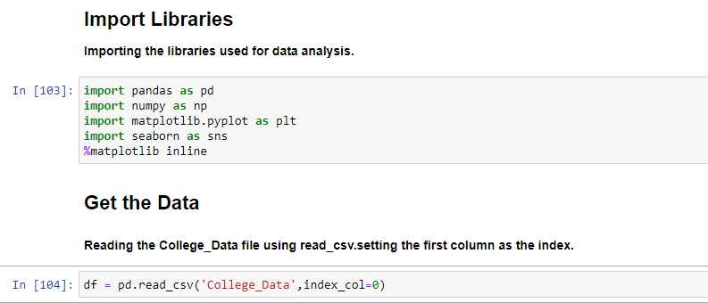
IMPLEMENTATION

Slide 7
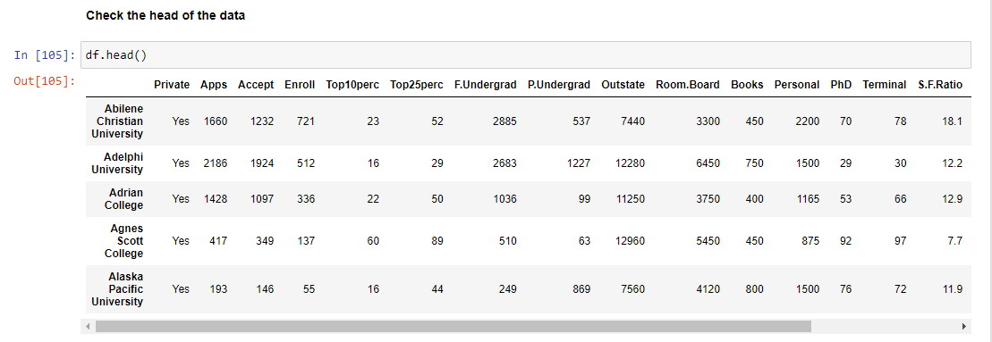
IMPLEMENTATION

Slide 8
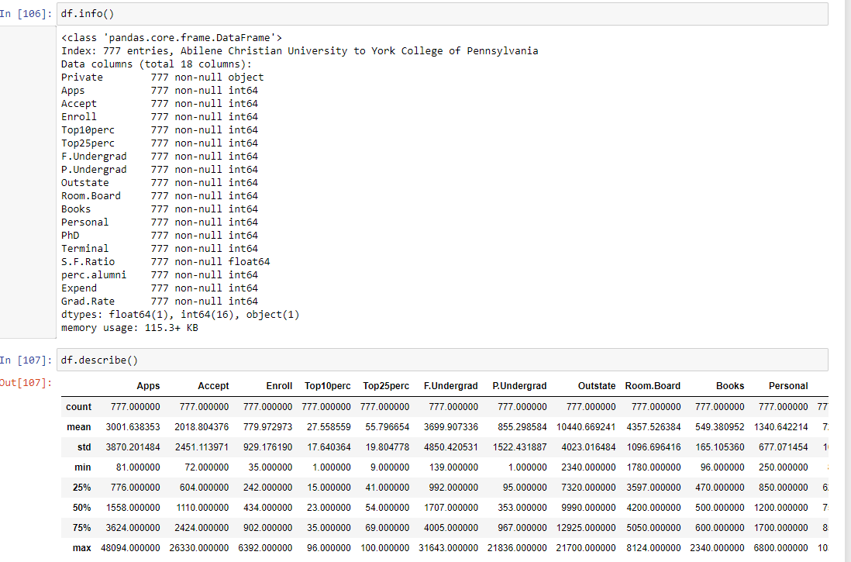
IMPLEMENTATION

Slide 9
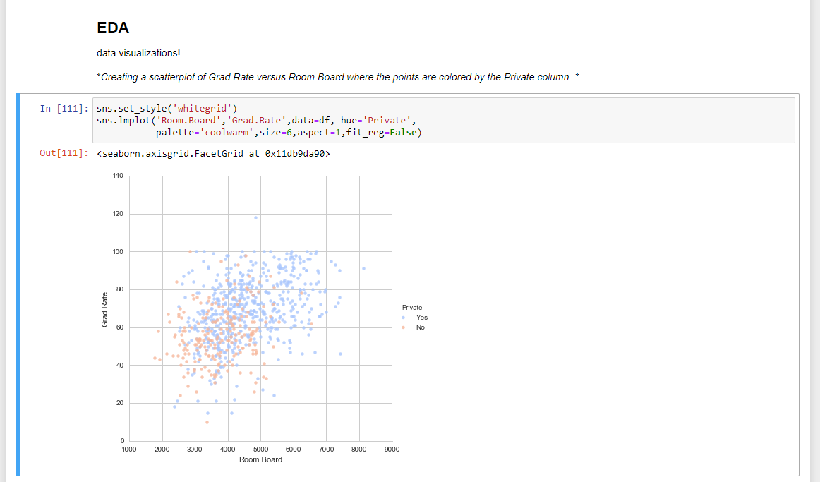
IMPLEMENTATION

Slide 10
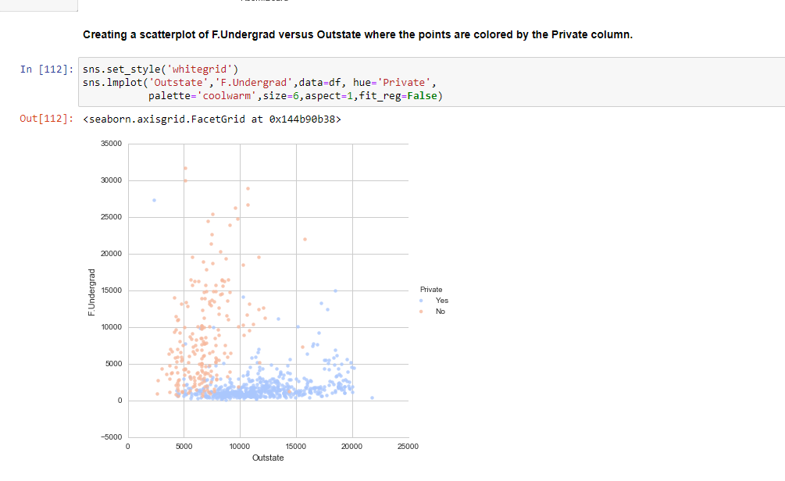
IMPLEMENTATION

Slide 11
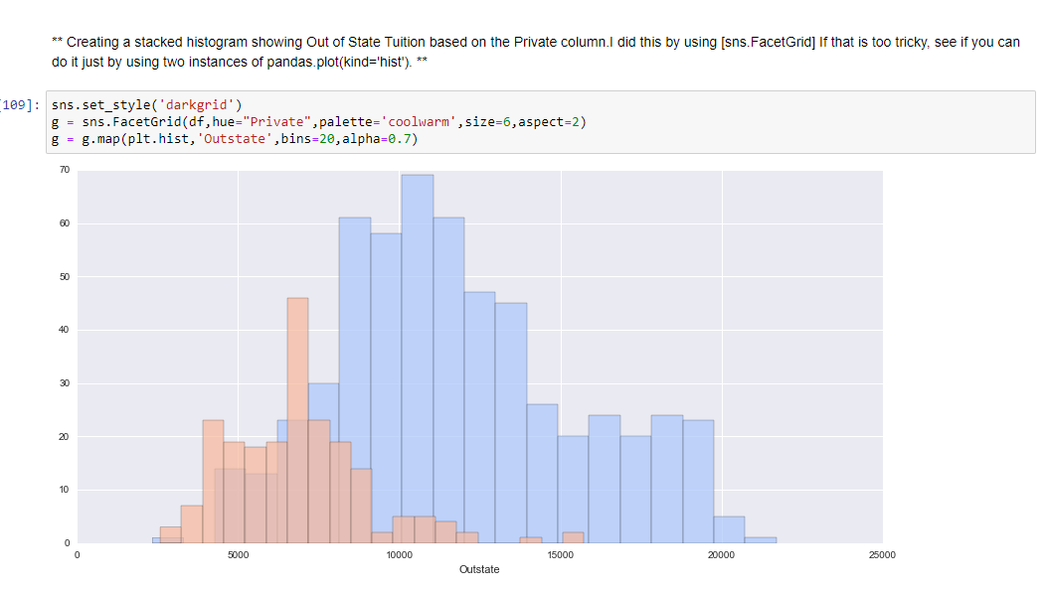
IMPLEMENTATION

Slide 12
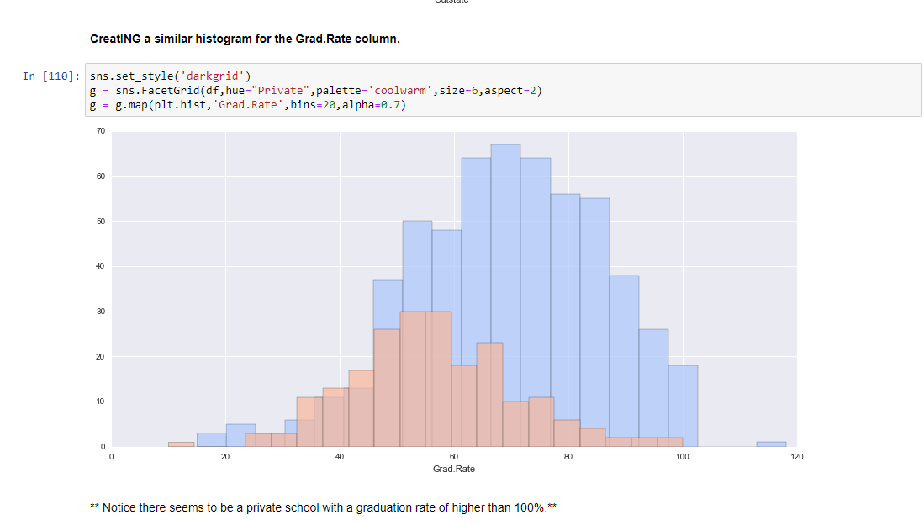
IMPLEMENTATION

Slide 13
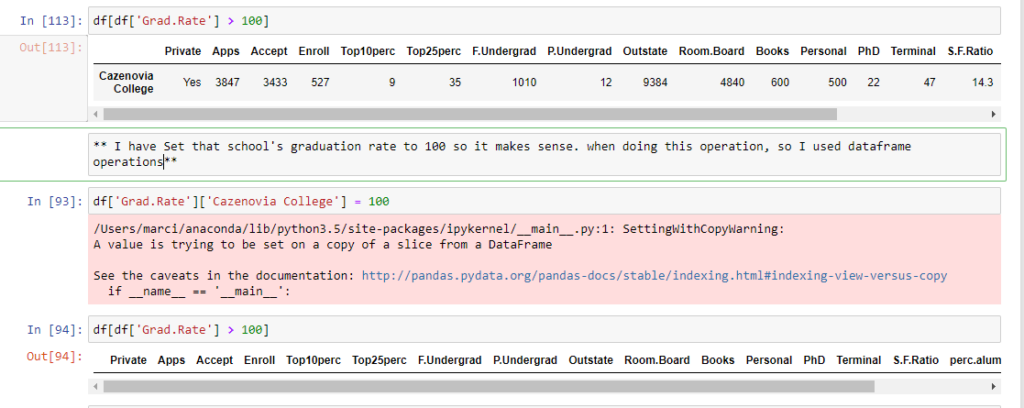
IMPLEMENTATION

Slide 14
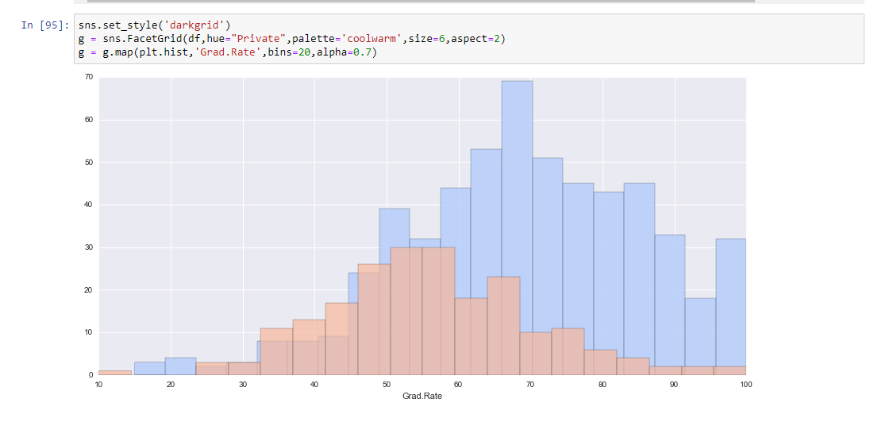
IMPLEMENTATION

Slide 15
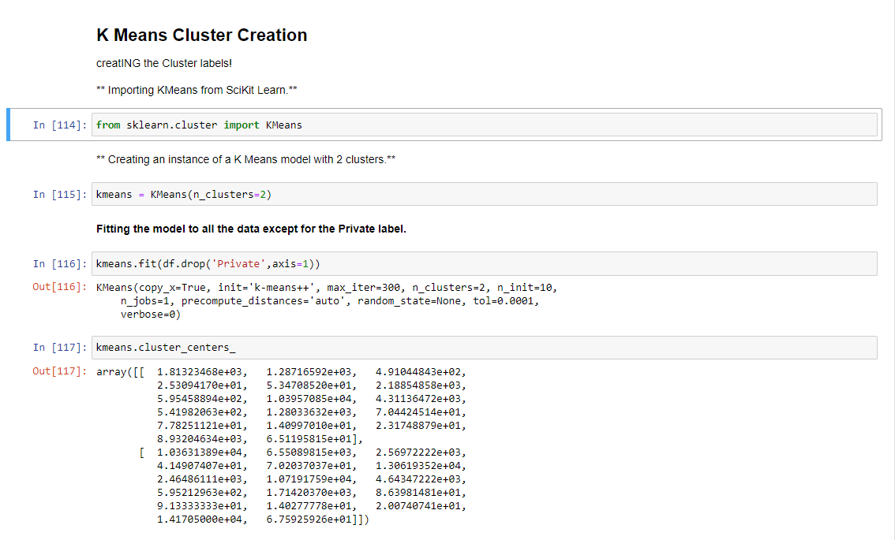
IMPLEMENTATION

Slide 16
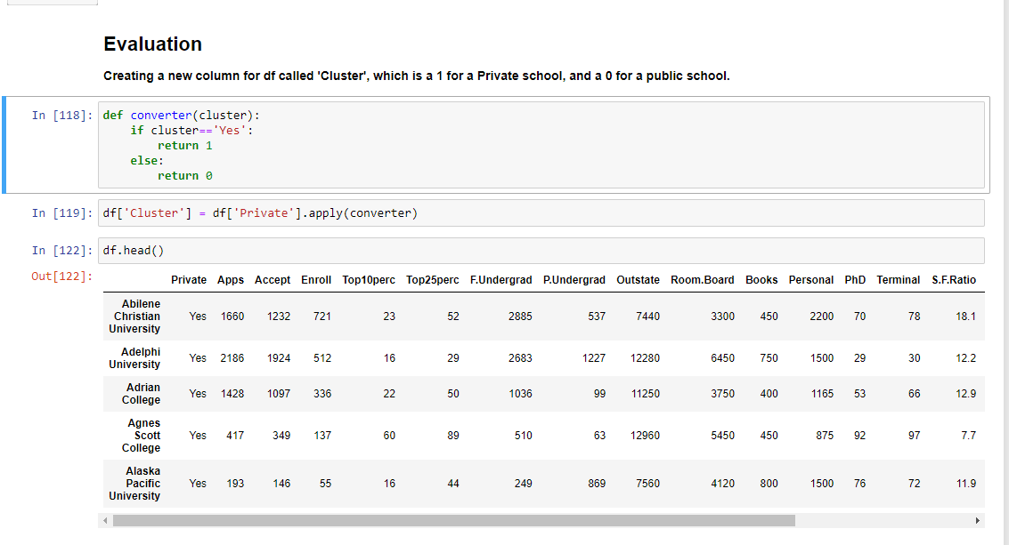
IMPLEMENTATION

Slide 17
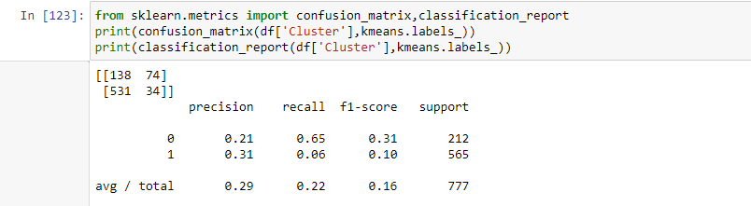
RESULT

Slide 18
CONCLUSION I have created a confusion matrix and classification report to see how well the Kmeans clustering worked by the end I can conclude that it was better considering the algorithm is purely using the features to cluster the universities into 2 distinct groups which happens in our real life

Slide 19
THANK YOU

